Slide 1
Chapter 19: Network and Distributed Systems

Slide 2
Chapter 19: Distributed Systems
Network Structure
Communication Structure
Network and Distributed Operating Systems

Slide 3
Network Structure
Local-Area Network (LAN) – designed to cover small geographical area
Consists of multiple computers (workstations, laptops, mobile devices), peripherals (printers, storage arrays), and routers providing access to other networks
Ethernet and/or Wireless (WiFi) most common way to construct LANs
Ethernet defined by standard IEEE 802.3 with speeds typically varying from 10Mbps to over 10Gbps
WiFi defined by standard IEEE 802.11 with speeds typically varying from 11Mbps to over 400Mbps.
Both standards constantly evolving

Slide 4
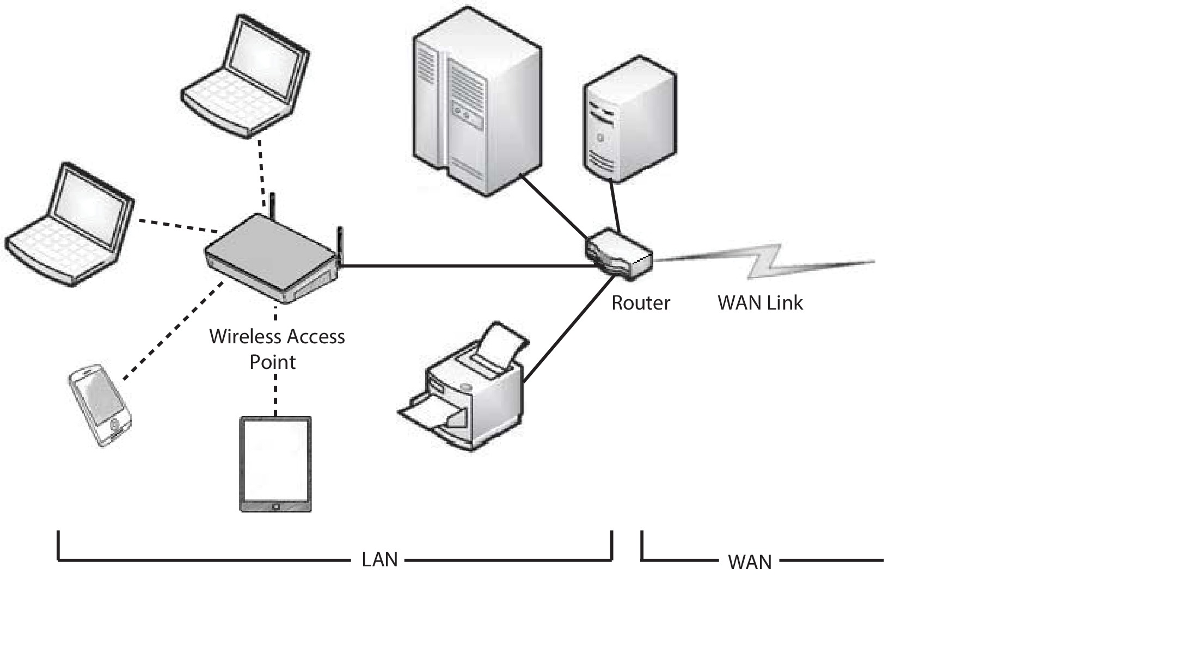
Local-Area Network (LAN)

Slide 5
Network Structure (Cont.)
Wide-Area Network (WAN) – links geographically separated sites
Point-to-point connections via links
Telephone lines, leased (dedicated data) lines, optical cable, microwave links, radio waves, and satellite channels
Implemented via routers to direct traffic from one network to another
Internet (World Wide Web) WAN enables hosts world wide to communicate
Speeds vary
Many backbone providers have speeds at 40-100Gbps
Local Internet Service Providers (ISPs) may be slower
WAN links constantly being upgraded
WANs and LANs interconnect, similar to cell phone network:
Cell phones use radio waves to cell towers
Towers connect to other towers and hubs

Slide 6
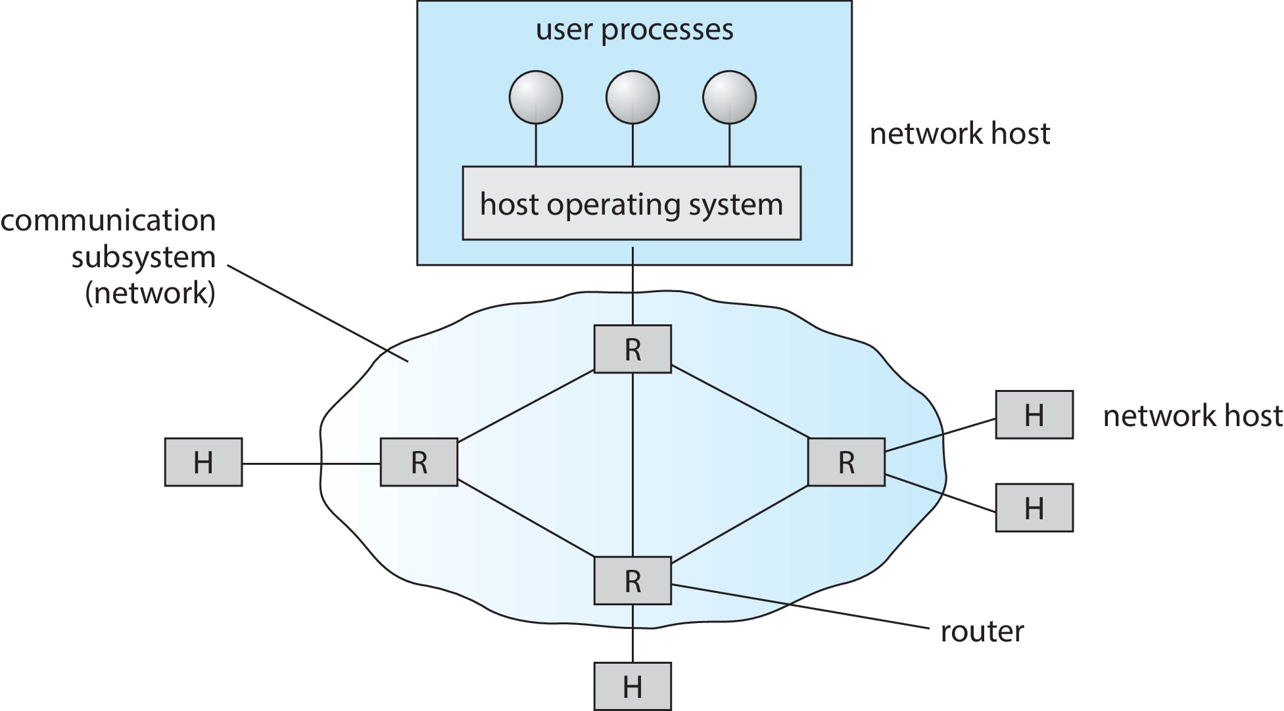
Wide-Area Network (WAN)

Slide 7
Communication Protocol
The communication network is partitioned into the following multiple layers:
Layer 1: Physical layer – handles the mechanical and electrical details of the physical transmission of a bit stream
Layer 2: Data-link layer – handles the frames, or fixed-length parts of packets, including any error detection and recovery that occurred in the physical layer
Layer 3: Network layer – provides connections and routes packets in the communication network, including handling the address of outgoing packets, decoding the address of incoming packets, and maintaining routing information for proper response to changing load levels

Slide 8
Communication Protocol (Cont.)
Layer 4: Transport layer – responsible for low-level network access and for message transfer between clients, including partitioning messages into packets, maintaining packet order, controlling flow, and generating physical addresses
Layer 5: Session layer – implements sessions, or process-to-process communications protocols
Layer 6: Presentation layer – resolves the differences in formats among the various sites in the network, including character conversions, and half duplex/full duplex (echoing)
Layer 7: Application layer – interacts directly with the users, deals with file transfer, remote-login protocols and electronic mail, as well as schemas for distributed databases

Slide 9
OSI Protocol Stack

Slide 10
Network-oriented Operating Systems
Two main types
Network Operating Systems
Users are aware of multiplicity of machines
Distributed Operating Systems
Users not aware of multiplicity of machines

Slide 11
Network Operating Systems
Users are aware of multiplicity of machines
Access to resources of various machines is done explicitly by:
Remote logging into the appropriate remote machine (ssh)
ssh kristen.cs.yale.edu
Transferring data from remote machines to local machines, via the File Transfer Protocol (FTP) mechanism
Upload, download, access, or share files through cloud storage
Users must change paradigms – establish a session, give network-based commands, use a web browser
More difficult for users

Slide 12
Distributed Operating Systems
Users not aware of multiplicity of machines
Access to remote resources similar to access to local resources
Data Migration – transfer data by transferring entire file, or transferring only those portions of the file necessary for the immediate task
Computation Migration – transfer the computation, rather than the data, across the system
Via remote procedure calls (RPCs)
Via messaging system

Slide 13
Distributed-Operating Systems (Cont.)
Process Migration – execute an entire process, or parts of it, at different sites
Load balancing – distribute processes across network to even the workload
Computation speedup – subprocesses can run concurrently on different sites
Hardware preference – process execution may require specialized processor
Software preference – required software may be available at only a particular site
Data access – run process remotely, rather than transfer all data locally
Consider the World Wide Web

Slide 14
End of Chapter 19

